Slide 1
Cloud Computing
By- Khushboo Raghani

Slide 2


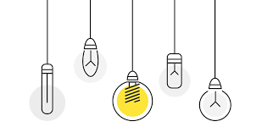
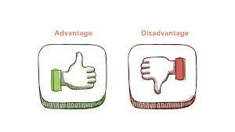
Agenda
Need of Cloud Computing
Models of
Cloud Computing.
What is
Cloud Computing?
Advantages &
Disadvantages
Some Real Examples

Slide 3
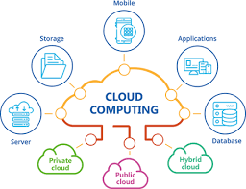
Cloud Computing
It is a technology that uses remote servers on the internet to store, manage, and access data online rather than local drives.
The data can be anything such as files, images, documents, audio, video, and more.

Slide 4



Before Cloud Computing
Buy a stack of servers
Keeping the peak traffic in mind , buy more servers
Monitoring and Maintenance

Slide 5



Disadvantages before Cloud Computing
Setup is Expensive
Troubleshooting problems can be tedious & may conflict with your business goals.
Traffic may vary,servers will be idle most of the time.

Slide 6



--Put your data on cloud servers
--No more buying expensive servers
Scalability! Your server capacity will vary according to traffic
Cloud provider will manage servers

Slide 7
Models of Cloud Computing
Deployment Model
Service Model
Infrastructure as service(IaaS)
Platform as service(PaaS)
Software as a service(SaaS)
Public Cloud
Private Cloud
Hybrid Cloud
Community Cloud

Slide 8
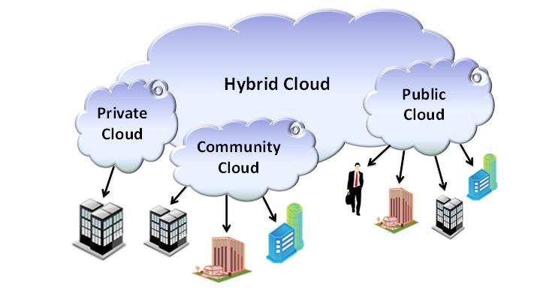
Deployment Model

Slide 9
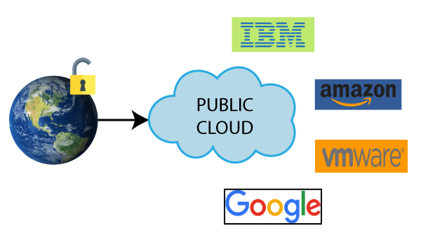
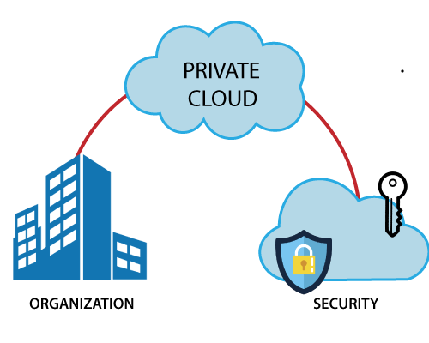
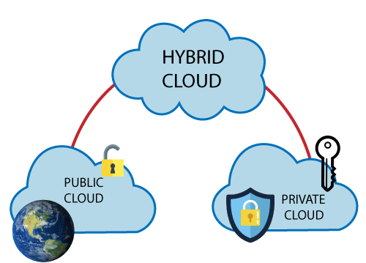
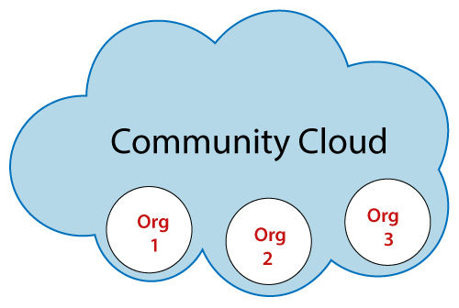
Deployment Model

Slide 10
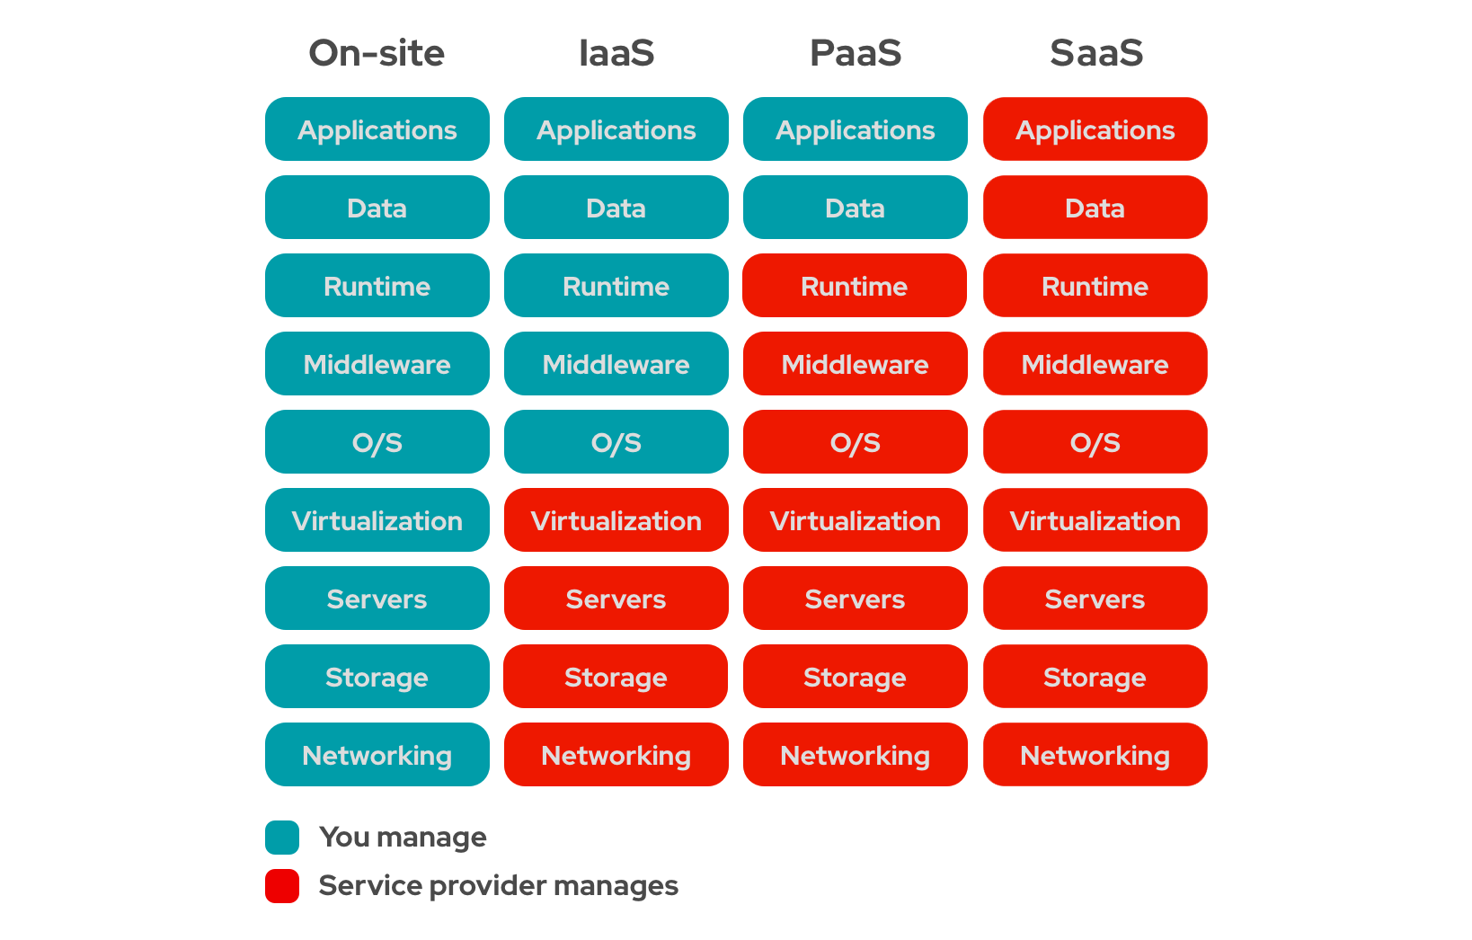
Service Model

Slide 11

Advantages of Cloud Computing
Say ‘Goodbye’ to costly systems
Data Centralization
Data Recovery
Sharing Capabilities
Cloud Security
Free Cloud Storage
Instantly Test

Slide 12
Data
Centralization
Free Cloud
Storage
Instantly Test
Data Recovery
Advantages of
Cloud Computing
Cloud Security
Say ‘Goodbye’
to costly systems
Sharing
Capabilities

Slide 13
Disadvantages of Cloud Computing
Net Connection
Low Bandwidth
Security Issues
Lack of full support
Incompatibility
Minimal flexibility
Cost Comparison

Slide 14
Areas | Applications
Cloud Storage | Dropbox, Gmail, Facebook
Marketing Cloud Platforms | Hubspot, Adobe Marketing Cloud
Education | SlideRocker , Ratatype, AWS
Healthcare | Dell’s Secure Healthcare Cloud, IBM Cloud
Government | IT consolidation, shared services, citizen services

Slide 15
Thank you
Notes:
<number>

